Slide 1
MGMT-6064 PROJECT LEADERSHIP AND MANAGEMENT
Module 4: Motivation

Slide 2
Objectives
What is motivation (intrinsic and extrinsic motivation)
Motivation theories:
Maslow’s Hierarchy of Needs
Herzberg Two-Factor (Motivator-Hygiene) Theory
Expectancy Theory
Goal-Setting Theory
Reinforcement Theory
Equity Theory
Implications for Project Managers

Slide 3

motivation
“Psychological forces that determine the direction of a person’s behaviour in an organization, a person’s level of effort, and a person’s level of persistence”
In other words, motivation is willingness to...
start working on a task
work hard on a task
continue working on a task until it is finished
…for the purpose of satisfying a need or receiving a desired outcome/ reward
Notes:
Image: https://plidonfernandes.files.wordpress.com/2014/12/motivation.jpg
Source (quoted definition): Jones, G.R., George, J.M. & Rock, M. (2007). Essentials of contemporary management. (2nd Cdn. Ed.). Toronto: McGraw-Hill Ryerson.

Slide 4
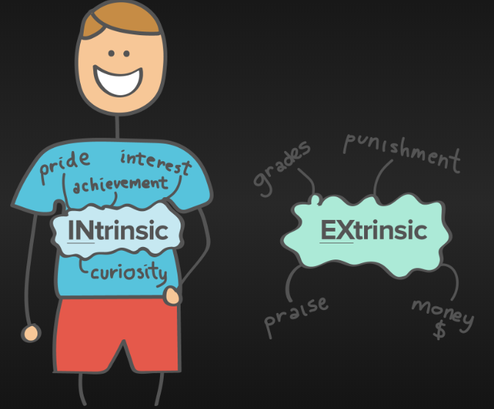
intrinsic & extrinsic motivation
Intrinsic motivation
Motivation comes from within us
We choose to do something because it is interesting, compelling or desirable – no one needs to tell us to do it
Motivation comes from doing the work itself
Extrinsic motivation
Motivation is externally driven
We choose to do something because of the consequences of the behaviour (e.g., money, praise, avoiding punishment)
Notes:
Image: https://www.velocity-pt.co.uk/wp-content/uploads/2017/01/Intrinsic-Extrinsic.png
Information Sources:
Arora, M. & Baronikian, H. (2013). Leadership in project management: Leading people and projects to success (2nd ed.). Toronto: Leadership Publishing House.
Jones, G.R., George, J.M. & Rock, M. (2007). Essentials of contemporary management. (2nd Cdn. Ed.). Toronto: McGraw-Hill Ryerson.

Slide 5
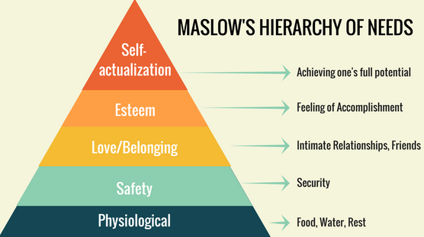
(Video)
Notes:
Image Source: https://cdn-images-1.medium.com/max/1600/0*vmojEZ3nGdboQ6_c.png
Video: show 7:10 to 9:30 in class, students can watch full video independently for full explanation of theory
About the video:
start at :45 – why use the hierarchy at work
identifies levels of hierarchy
lower level needs must be satisfied first
1:50 – physiological needs; 2:15 – safety needs; 2:50 – belongingness; 3:34 – esteem; 4:36 – self-actualization
two types of esteem needs: self-esteem (self-respect, achievement), and desire for reputation/appreciation/respect
self-actualization: you don’t care what others think about yourself/your ideas, urge for personal development, creative urges, etc.
5:20: three bottom layers are deficiency needs (they must be met for employees to function properly at work); two upper layers are growth needs (they will never be completely satisfied, people will strive for more of them)
if needs aren’t met, employees will look for other ways to satisfy them (e.g., social activities, family, sports, changing jobs)
7:10: example – salesperson completes a large sale to 8:20
8:20-9:30 – applying hierarchy at work; if the work tasks are routine, then managers can focus on addressing deficiency needs; if the tasks are complex or requires creativity and independence, then e’r should also focus on satisfying growth needs
9:30 – criticism – some cultural differences, research doesn’t support it, theory doesn’t explain why ‘starving artists’ exist, we don’t need to satisfy only one need at a time [these criticisms are also mentioned in the Jones et al. reading]

Slide 6
Implication for project leaders
Each team member is motivated by unique needs which may change from time to time
Get to know your team members and what motivates them!
Your techniques to motivate team members may work for some but not others
If team member tasks are routine, focus on addressing three lowest level needs (deficiency needs)
If team member tasks are complex or creative, focus on satisfying growth needs after lower level needs are addressed

Slide 7
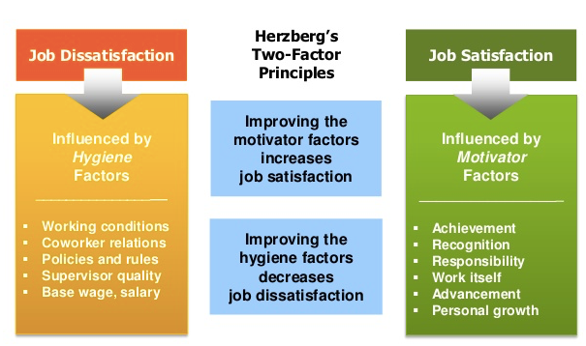
Herzberg’s two factor ‘Motivation-Hygiene’ Theory
Video
Notes:
Source: https://s3-us-west-2.amazonaws.com/courses-images/wp-content/uploads/sites/143/2017/02/04203023/Herzberg.png
About the video:
start to 3:40 – explains the theory
“you must fix the hygiene factors before you create motivators” [consistent with assigned article about Herzberg Theory]
3:40 - - description of various hygiene factors: security, status, interpersonal relations, personal life, salary, working conditions, supervision, company policies
6:20 – description of various motivator factors: growth, advancement, responsibility, meaningful work, recognition, sense of achievement
8:32 – using the model in the workplace: eliminate dissatisfaction (fix poor policies, provide supportive supervision, culture of respect, fair compensation, provide job security), THEN help e’es achieve satisfaction (provide opportunities for achievement and advancement, recognize contributions, create rewarding and challenging work, give responsibility, offer training)
11:08 – criticism: people have individual ideas about what constitutes hygiene and motivation factors for them; what is ‘satisfaction’? (there are parts of all jobs that people don’t like); research was based on white-collar workers; nevertheless, theory is useful tool for managers

Slide 8
Implication for project leaders
Fix the hygiene factors before you create motivators
Poor hygiene factors are de-motivating
Improving the motivator factors will lead to greater job satisfaction and motivation
Free coffee and soda in the staff kitchen will not motivate people to give their best effort to their project tasks…. but it will make them less grumpy

Slide 9
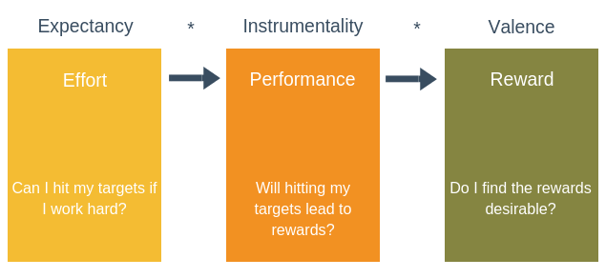
Expectancy Theory (Vroom)
Motivational force =
(Video example of low instrumentality)
Notes:
https://expertprogrammanagement.com/wp-content/uploads/2018/10/Expectancy-Theory.png
A general, informal definition of instrumentality: the usefulness or utility of something as a ‘means to an end’. For example, you are swimming in an ocean and a shark approaches. You panic and splash water at it, to make it go away. One might say that your action has low instrumentality.
A general, informal definition of valence: Valence is a fancy word for the value or attractiveness of an idea, situation, event, object (etc.). For example: “When deciding whether a new project will be profitable for your business you must judge it on its future valence. [example is from http://www.businessdictionary.com/definition/valence.html” ]
(Note: video link is from ‘Shaun of the Dead’ movie)

Slide 10
Implication for project leaders
Encourage your team members to believe that they can succeed if they try hard (excessive criticism decreases expectancy levels)
But… if you assign work to team members that is beyond their ability, motivation will decrease
Link performance to desired outcomes and communicate this – reward people who have earned it (to increase instrumentality levels)
Understand the outcomes/rewards that are valuable to each of your team members (to increase valence levels)
Notes:
Source : Jones, G.R., George, J.M. & Rock, M. (2007). Essentials of contemporary management. (2nd Cdn. Ed.). Toronto: McGraw-Hill Ryerson.

Slide 11

Goal-setting theory (locke & Latham)
SMART goals are better motivators than vague or unclear goals
‘Buy-in’ and feedback increase likelihood of success (when setting goals for the project team)
Notes:
Image: https://cdn.corporatefinanceinstitute.com/assets/smart-goal-1.jpeg

Slide 12
Implications for project leaders
Look for ways to formulate goals and expectations in a ‘SMART’ way
Where possible, consult with stakeholders when setting goals and expectations
Track and monitor progress towards goals, and provide feedback to increase likelihood of success
Notes:
Image: https://cdn.corporatefinanceinstitute.com/assets/smart-goal-1.jpeg

Slide 13
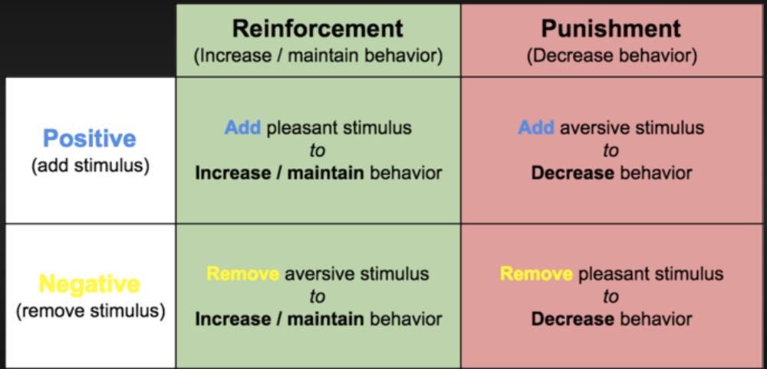
Reinforcement Theory (skinner)
Spot the mistake in this video!
(Skinner’s Box video)
“Positive Reinforcement”
“Punishment”
“Negative Reinforcement”
“Extinction”
Notes:
http://militarymentors.org/wp-content/uploads/2016/08/yjh0qdsqlzlkxwt2zwgs.png
(watch first thirty seconds of Skinner’s Box video)

Slide 14
Implications for project leaders
Positive reinforcement should be one of your more commonly used motivation tools
Demonstrates that positive behaviours have positive consequences
Avoid excessive use of negative reinforcement (e.g., threatening to fire a team member)
Punishment can have unintended side-effects (e.g., retaliation)
Be consistent with reinforcement so that behaviour becomes “learned”

Slide 15
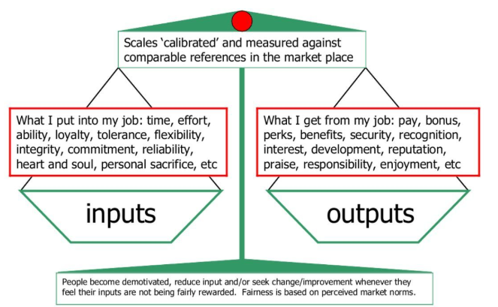
Equity theory (adams)
(video)

Slide 16
Implications for project leaders
Team members expect to receive a “fair” reward in exchange for their efforts
Team members will compare their inputs and outputs (or efforts and rewards) with other referents
Themselves in other situations (e.g., on a previous project)
Others who are in the same current situation
Others who are not in the same current situation
Etc.

Slide 17
Implications for project leaders (cont’d)
If team members perceive that inequity exists, motivation will decrease AND they will seek to reduce the inequity
Altering inputs or outputs
Distorting inputs or outputs in their minds (“cognitive distortion”)
Leaving
“Fairness” is subjective! What YOU believe is “fair” may not be what others believe

